Slide 1



Electronic Propellant Feed System
Johnny Froehlich, Jonathan Talik, James Luce, Rawand Rasheed, Mimi Shang, Jordan Roland
Affiliations: ¹Portland State Aerospace Society, ²Maseeh College of Engineering and Computer Science Portland, OR, 97201, United States

Slide 2
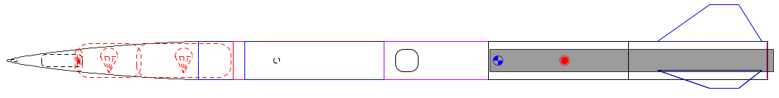
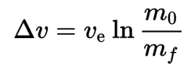
The problem
Portland State Aerospace Society (PSAS) wants its rockets to go higher.
The rocket equation dominates:
Δv = change in velocity
V_{e} = exhaust velocity
m_{o} = mass of rocket + propellant
m_{f} = mass of rocket

Slide 3
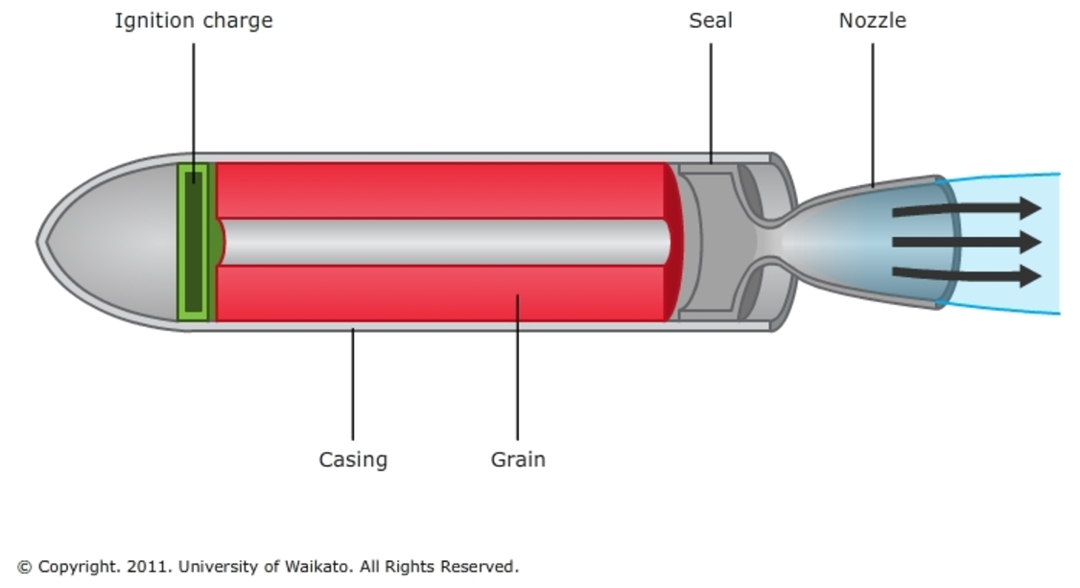
Past approach
Most small rockets use solid propellant.
Solid propellant is easy but inefficient.
Can’t throttle solid rockets = can’t insert into orbit.

Slide 4
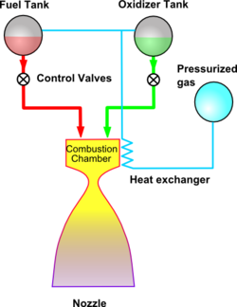
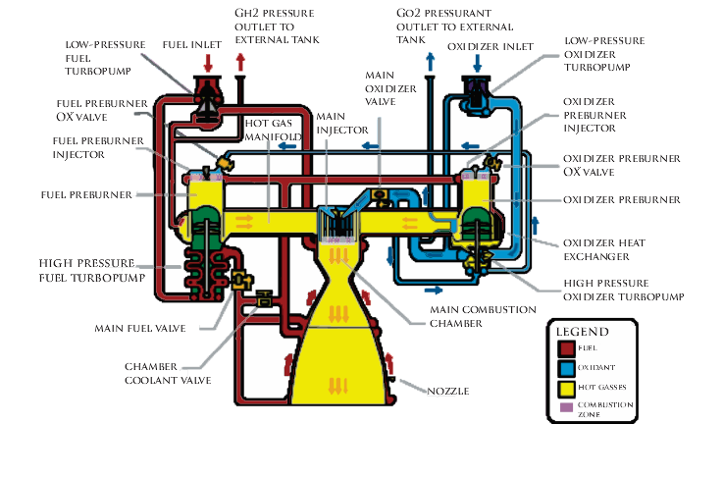
Liquid propellant
Liquid propellant gives more Δv for its mass.
Common approaches:
Pressure fed: too heavy
Turbopump: too complex
Images from wikipedia

Slide 5
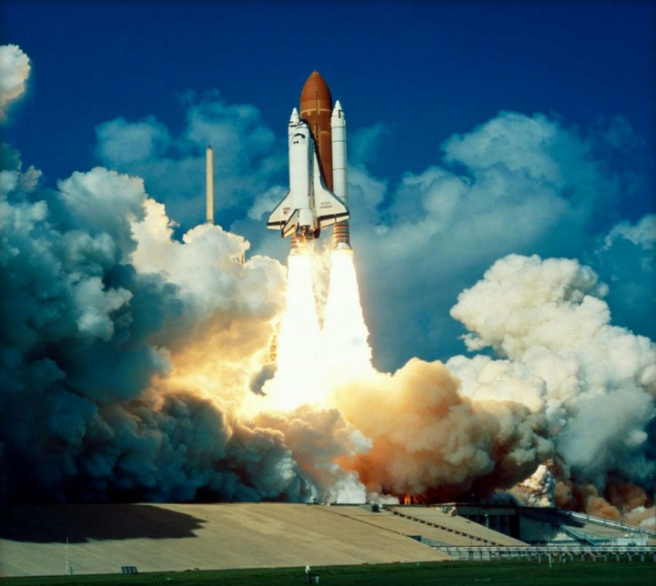
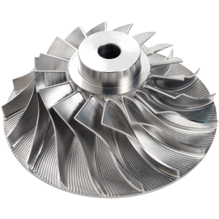
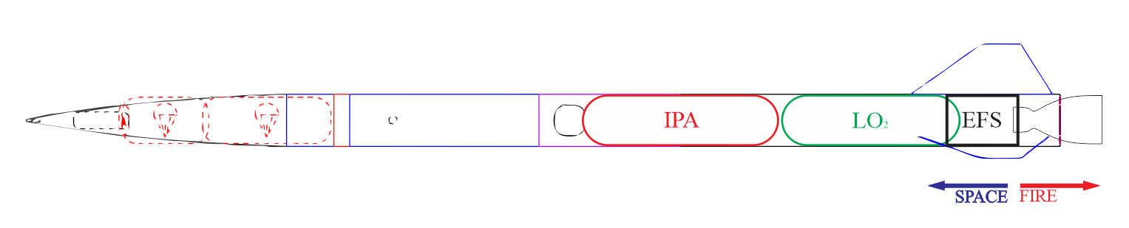
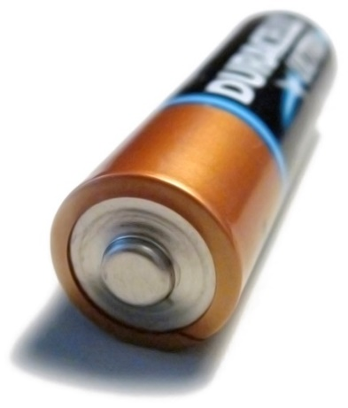
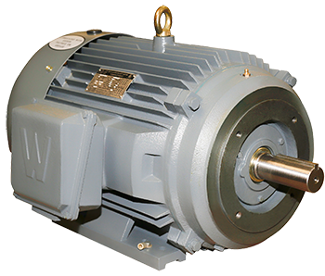
Electric motors: a new approach?
Remove the turbine from a turbopump = just a pump.
Battery energy density has been rising.
This is a new space in rocketry.
https://en.wikipedia.org/
http://www.blue-sky-technologies.com/impeller-seal-repair/
http://www.worldwideelectric.net/

Slide 6
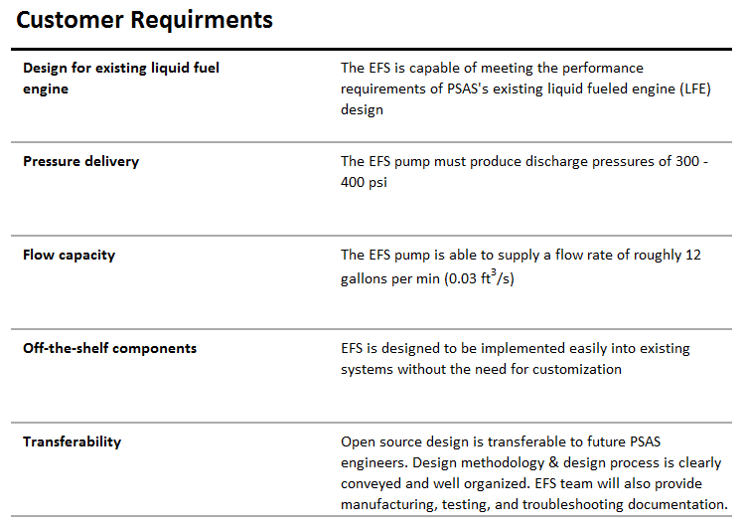
Portland State Aerospace Society | Electric Propellant Feed System
6
Notes:
6

Slide 7
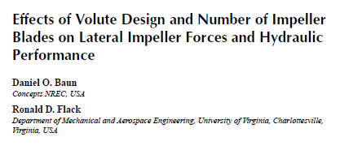
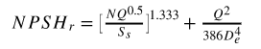
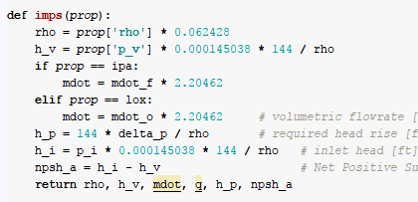
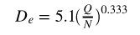
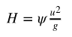
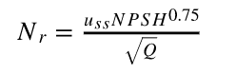
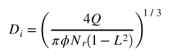
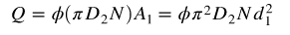
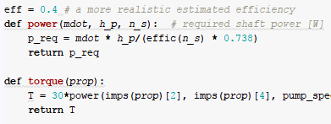

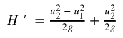
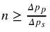
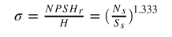
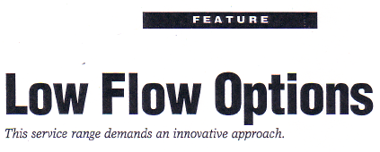
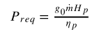
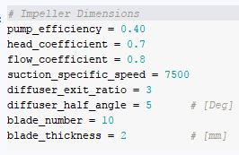
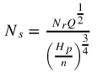
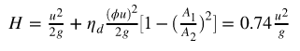
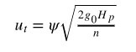
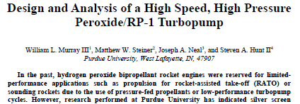
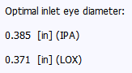
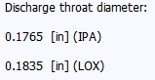
Open-ended literature review
Puzzle break
Scientific computing
We made some guesses too
7
Notes:
7

Slide 8
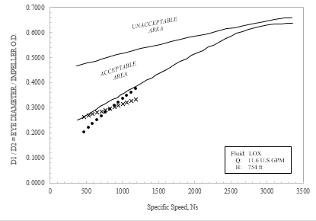
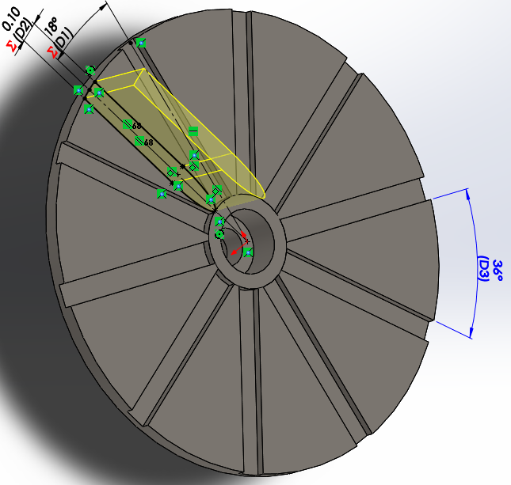
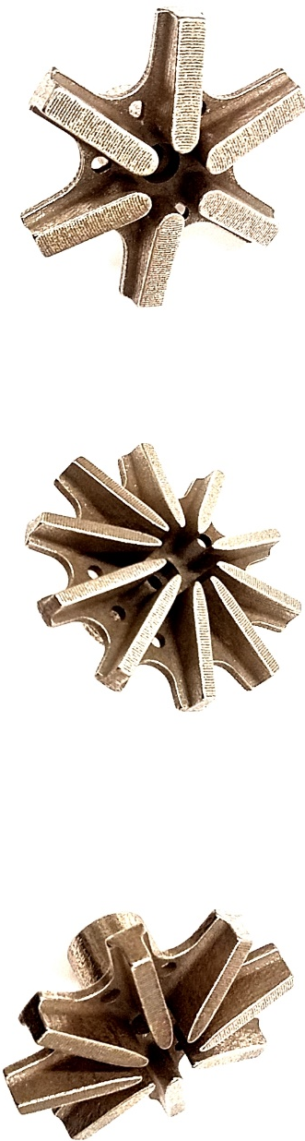
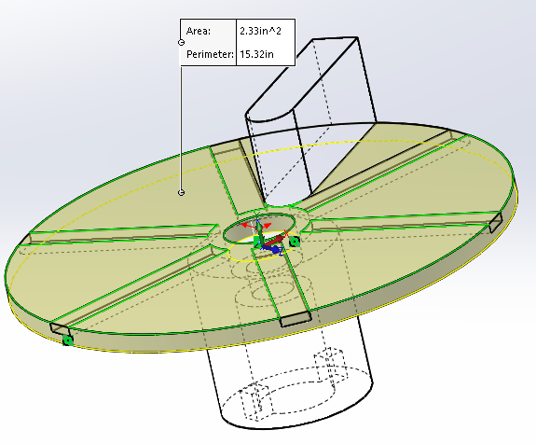
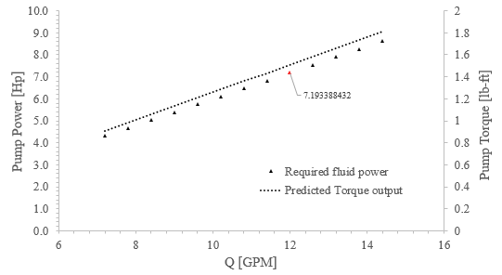
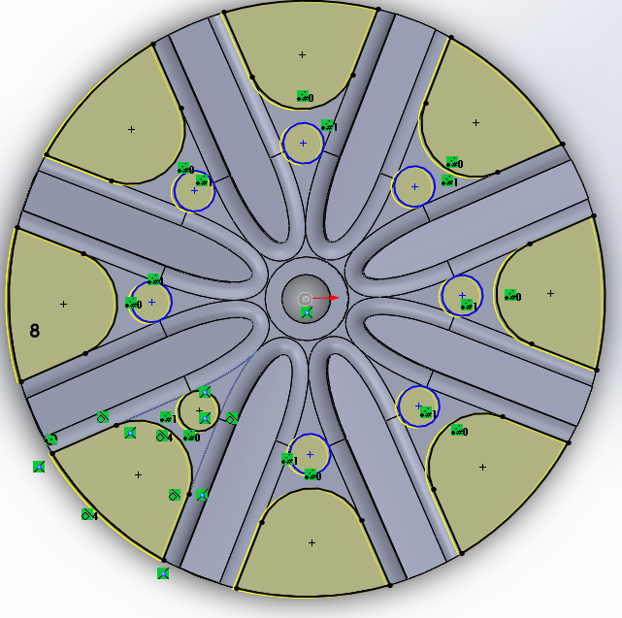
Map out predictions
Play with the design
Create something
You are here
8
Notes:
8

Slide 9
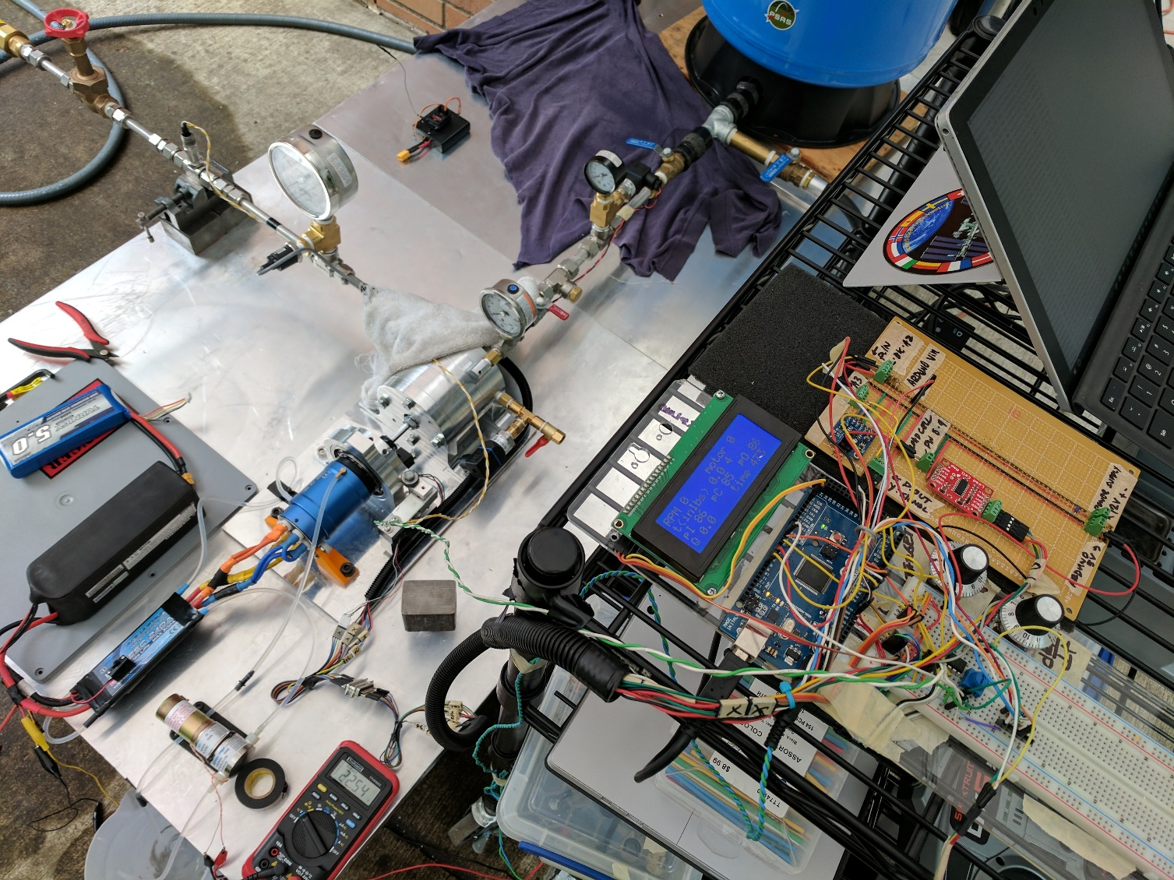
Final Design: Review
To insert:
Flow diagram of testing apparatus – Diagram
Actual Testing Assembly – High res photo
Notes:
look at the thing we created: a testing and development platform for an electric feed system
Portland State Aerospace Society | Electric Propellant Feed System

Slide 10
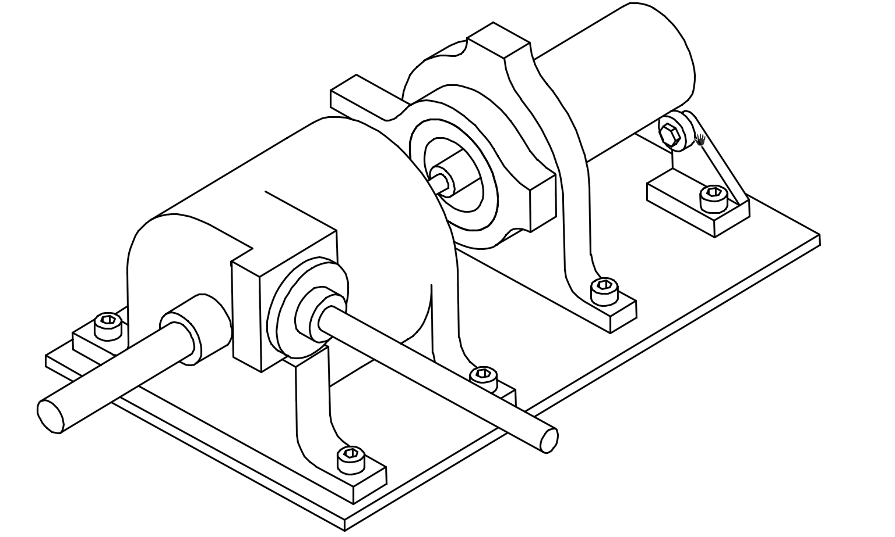
Electric Feed System
Pump
Testing
Casing
Drive
Flow Loop
Measurement
Hydraulic
Motor
Flow Loop
Pressure
Mechanical
Control
Air Pressure
Flow
Bearings
Batteries
Water
RPM
Seals
Dyno Mount
Seals
Torque

Slide 11
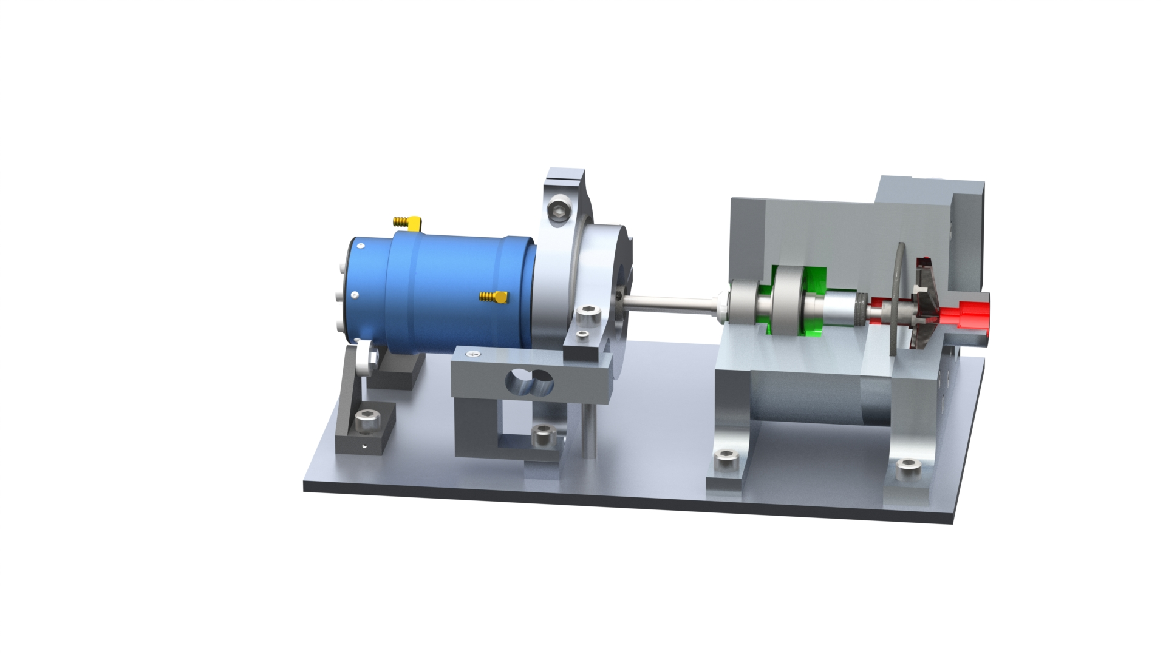
Notes:
Subsystem breakdown:
Pump:
Bearing system
Seal system
Hydraulic system ( volute, impeller, diffuser) – highlight modular design
Shaft
To insert:
Quarter section – CAD
Photo of the pump w/ casing – High Res
Final Design: Subsystem
Portland State Aerospace Society | Electric Propellant Feed System

Slide 12
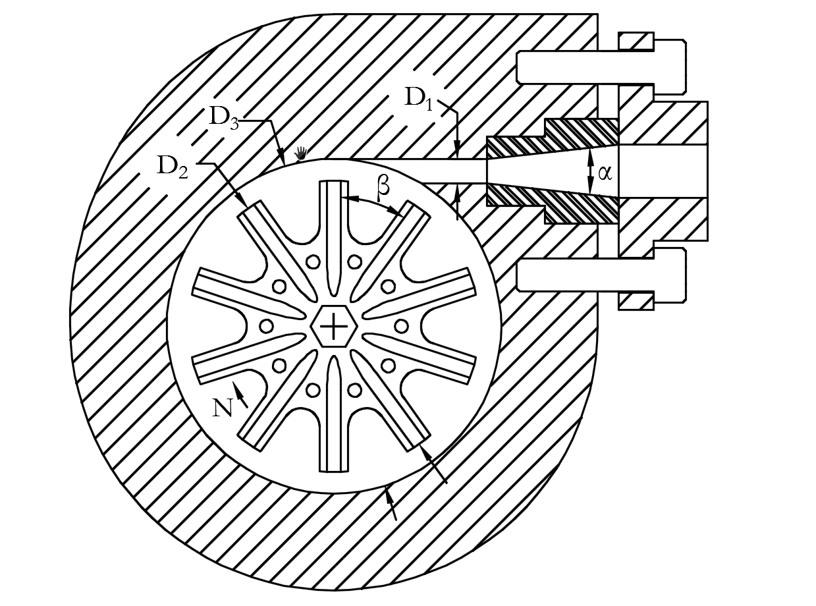
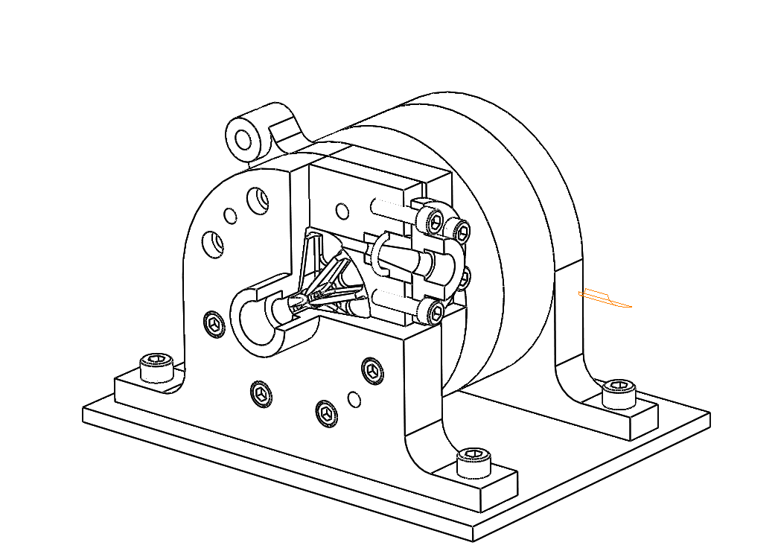
Notes:
Hydraulic design
To insert:
WIT
SECTION VIEW
Final Design: Review
Performance parameters of EFS partial emission pump
Discription |  |  | Value
Q (G.P.M) |  |  | 12
H (ft) |  |  | 754
N_{r} (r/min) |  |  | 20500
P (KW) |  |  | ≤ 3.5
Structure parameters of EFS partial emission pump
Discription |  |  | Value
Impeller Outlet Diameter D₂(in) |  |  | 2.1
Impeller Blade width b₂(in) |  |  | 0.2
Discharge Throat Diameter D₁(in) |  |  | 0.18
Impeller eye Diameter D_{e}(in) |  |  | 0.43
No. of Blades |  |  | 10
Impeller Discharge Angle β(̊) |  |  | 36
Base Diameter of Volute Caseing D₃(in) |  |  | 2.42
Length of Diffuser section L_{D}(in) |  |  | 1.2
Diffusion Angle α(̊) |  |  | 8
Portland State Aerospace Society | Electric Propellant Feed System

Slide 13
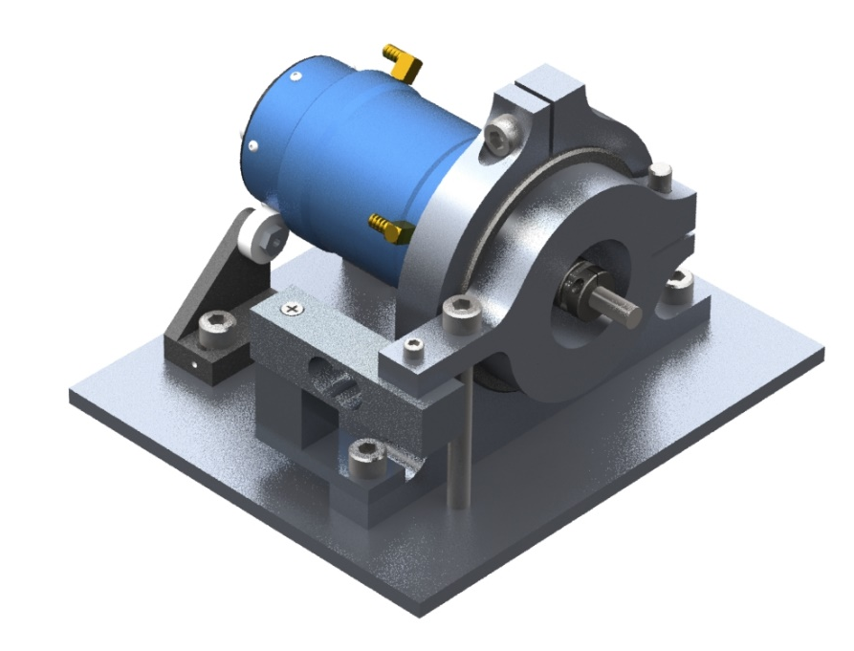
Notes:
Subsystem breakdown:
Drive:
Motor / esc / battery / control
Motor Dyno mount (floating torque measurement)
Motor coupling – Alignment and verifying runout (angular / offset)
To insert:
Rendering of the motor dyno – CAD
Photo or diagram of the motor
Final Design: Subsystem
Motor Dynamometer Mount
Portland State Aerospace Society | Electric Propellant Feed System

Slide 14
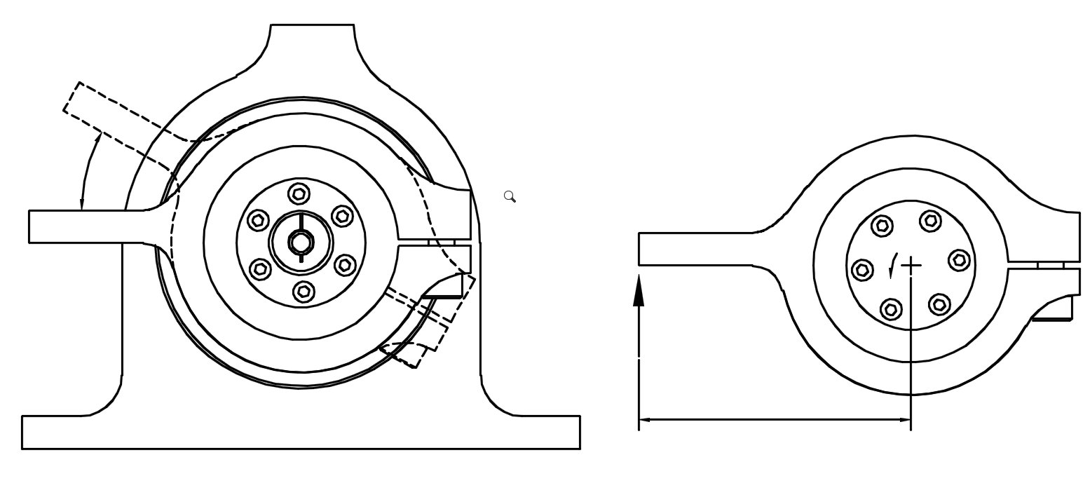
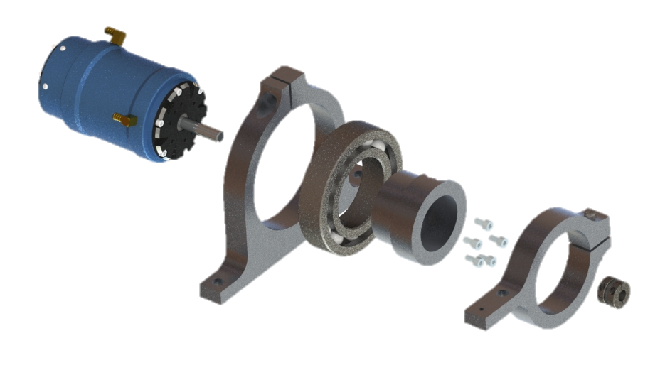
Notes:
Subsystem breakdown:
Drive:
Motor / esc / battery / control
Motor Dyno mount (floating torque measurement)
Motor coupling – Alignment and verifying runout (angular / offset)
To insert:
Rendering of the motor dyno – CAD
Photo or diagram of the motor
Final Design: Subsystem
Motor Mounting and Control
T
R
L
Portland State Aerospace Society | Electric Propellant Feed System

Slide 15
Final Design: Subsystem
To insert:
Flow diagram of testing apparatus – Diagram
Photo of the testing apparatus – high res photo
Photo of DAQ / measurement / harness
Notes:
Subsystem breakdown:
Testing Apparatus:
Tank, suction line, discharge, experimental procedure, cooling
Sensing
Pressure, flow, RPM, Torque
Data Acquisition
Arduino to excel
Currently not in use….
Portland State Aerospace Society | Electric Propellant Feed System

Slide 16
Performance Testing
Notes:
Centrifugal pump is a complex turbomachine
Purely analytical prediction not possible
Hence, performance is obtained empirically

Slide 17
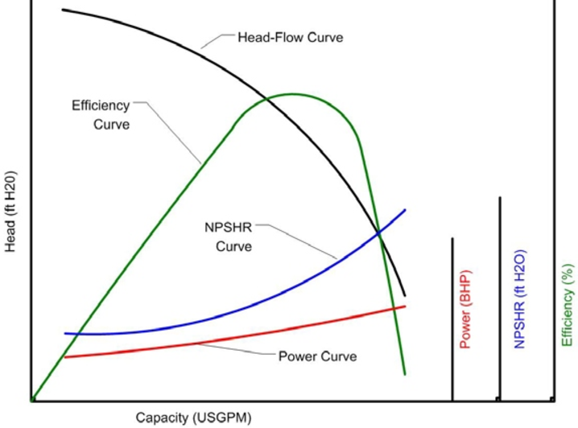
Characterizing the performance of Piglet
Using Hydraulic Test Standard (ANSI/HI 14.6)
Typically performance is given by curves of:
• Head versus capacity
• Power versus capacity
• NPSH versus capacity
Hydraulic Institute Test Standard (ANSI/HI 14.6 "Rotodynamic Pumps for Performance Acceptance Tests," 2011)
Notes:
We followed hydraulic standards intended to demonstrate hydraulic performance and mechanical integrity
• Head versus capacity
Using head and not pressure = head-capacity performance independent of the specific gravity of the liquid.
• Power versus capacity
BHP and WHP
• NPSH versus capacity
Lengthy description of value is unavoidable. Love to explain at the showcase
– Maximum head is at zero capacity
– The maximum capacity of the pump

Slide 18
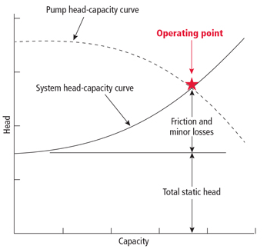
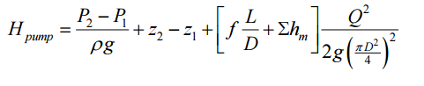
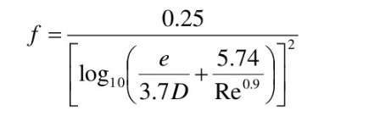

System Characteristics
Energy Equation
Swamee-Jain Equation (1976)
Explicit expression 10⁻⁶ < e/D, 10⁻²; 5000 < N^{R} < 10⁸
Notes:
HEAD OF PUMP VS SYSTEM HEAD
The height to which a pump can raise the water is the pump head and it is measured in meters (feet) of flowing water. The head required to overcome the losses in a pipe system at a given flow rate is called the system head.
Using head and not pressure = head-capacity performance independent of the specific gravity of the liquid.
Energy equation
Each of these individual total heads = sum of the static pressure head, velocity head and elevation head.
That is, analyze the system to determine the pump head required as a function of flow rate through the pump … This will form the system line.
Plotting the pump curve and system curve will result in an intersection point, which is called the operating point.
Friction head
The friction head consists of the sum of the pipe friction head losses in the
Velocity head
Velocity head The velocity head is the kinetic energy contained in the water being pumped at any point in the system

Slide 19


Slide 20


Centrifugal Pump Performance @ 16,500 rpm
Figure: EFS model PIGLET-1 2.1in Diam. Impeller experimental results at 16500 rpm.
Notes:
The NPSH always rises as the centrifugal pump capacity approaches shut‑off (zero flow rate).
minimum value at a capacity Q about 40 percent of the best‑efficiency capacity

Slide 21




Vs.
Z = 10
Z = 6
10 Blades
Slightly higher (~ 2 %) discharge pressures for a given flow rate.
6 Blades
Lower chamber pressures (~ 8 %)
Earlier run-out (lower max. flow)
Notes:
Effects of blade number variation on performance involves many hydrodynamic considerations.
We are hesitant to draw any meaningful conclusions at this point in the testing/analysis
This slide serves as an example us switching from the engineering side of things to the science side of things.
Where we study the behavior of the system in a more general and exploratory way
Possible
Frictional loss effects
An increases of interface between fluid stream and blade can cause an increment of hydraulic loss

Slide 23


Notes:
A centrifugal pump is a very complex turbomachine, and purely analytical prediction of its performance is not possible. Hence, performance is obtained empirically.
Despite the low efficiency, regenerative ring pumps have several advantages over other turbomachines with similar tip speed due to relatively low manufacturing costs, simplicity, high reliability, enhanced priming behavior and can in many applications offer a more efficient alternative.

Slide 24






Blade number affects efficiency and introduces circulatory losses (too few blades) and passage losses (too many blades)
Notes:
operating the pump against close valve for a long time causes considerable damage on the pump since almost all the motor power is transformed into thermal energy which is absorbed by the pumped liquid.
Straight radial vane impeller in a single emission point
affinity laws should only be used for impeller trims of about 5 percent

Slide 25
Challenges / Solutions: Fabrication

Slide 26



Challenge: Fabrication
Head v. flow requirements meant commercially available pumps wouldn’t work.
Outsourcing fabrication would be cost prohibitive.

Slide 27




Challenge: Precision
High speeds and loads with low tolerances meant fabrication had to be precise.
+/- ~0.0007”
0.06” +/- 0.01”

Slide 28



Solution: Time investment
Designed parts around available fabrication techniques.
Learned 3-axis CNC mill and 2 axis CNC lathe.
Several thousand (wo)man hours in the shop.

Slide 30

Unfinished Business: Controls and Safety
More robust (read safe) controls system
Clean up wiring
Either a dedicated transmitter set up or hard wired throttle control
Replace all gauges with data

Slide 31
Unfinished Business: Lessons
Pump is over-designed but for a reason

Slide 32



Next steps:
Design it for really fucking cold
Make FIRE!!!!
Full suite of testing

